Slide 1
Fundamental Concepts of Database Systems
Prof. Saed SAYAd
CS527

Slide 2
Introduction
Applications of Database Technology
Key definitions
File versus Database Approach to Data Management
Elements of a Database System
Advantages of Database Systems and Database Management

Slide 3
Applications of Database Technology
Storage and retrieval of traditional numeric and alphanumeric data in financial applications
Multimedia applications (e.g., YouTube, Spotify)
Biometric applications (e.g., fingerprints, retina scans)
Wearable applications (e.g., FitBit, Apple Watch)
Geographical Information Systems (GIS) applications (e.g., Google Maps)
Sensor applications (e.g., printers, nuclear reactor)
Internet of Things (IoT) applications (e.g., Telematics)

Slide 4
Key definitions
A database can be defined as a collection of related data items within a specific business process or problem setting
has a target group of users and applications
A Database Management System (DBMS), is the software package used to define, create, use and maintain a database
consists of several software modules
DBMS
Databases
Tables
Columns and Rows
Values (data)

Slide 5
File versus Database Approach to Data Management

Slide 6
File versus Database Approach to Data Management
File approach
duplicate or redundant information will be stored
danger of inconsistent data
strong coupling between applications and data
hard to manage concurrency control
hard to integrate applications aimed at providing cross-company services

Slide 7
File versus Database Approach to Data Management

Slide 8
File versus Database Approach to Data Management
Database approach
superior to the file approach in terms of efficiency, consistency and maintenance
loose coupling between applications and data
facilities provided for data querying and retrieval

Slide 9
File versus Database Approach to Data Management
File approach
Procedure FindCustomer;
Begin open file Customer.txt;
Read(Customer)
While not EOF(Customer)
If Customer.name='Bart' then
display(Customer);
EndIf
Read(Customer);
EndWhile;
End;
Database approach (SQL)
SELECT *
FROM Customer
WHERE name = 'Bart'

Slide 10
Elements of a Database System
Database Model
Data Model
Catalog
Database Users
Database Languages

Slide 11
Database Model
Database model A database model fundamentally determines in which manner data can be stored, organized and manipulated. The most popular example of a database model is the relational model
Database state represents the data in the database at a particular moment
also called the current set of instance
typically changes on an ongoing basis

Slide 12
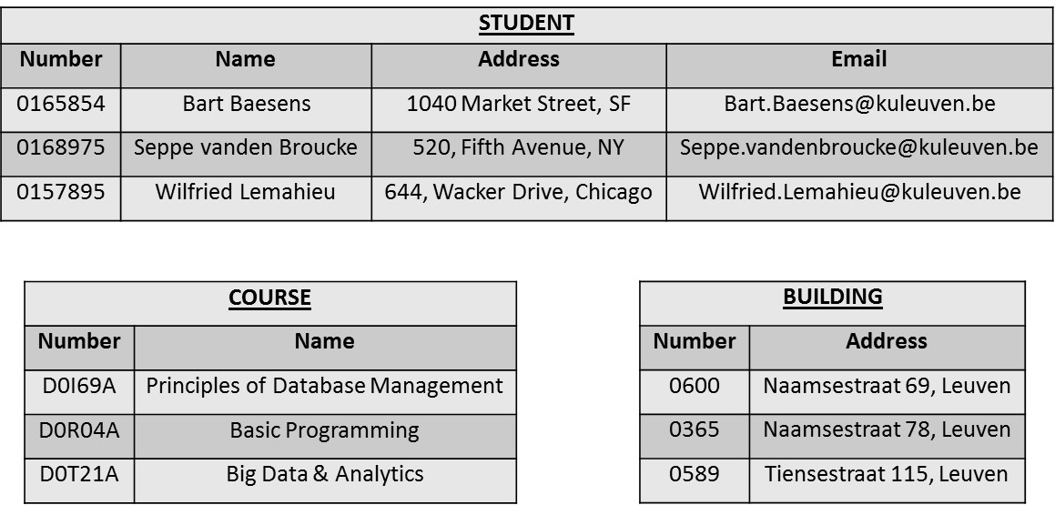
Database State

Slide 13
Data Model
A data model provides a clear and unambiguous description of the data items, their relationships and various data constraints.
There are four types of data model or schema:
Conceptual
Logical
Physical
External

Slide 14
Data Model - Conceptual
A conceptual data model provides a high-level description of the data items with their characteristics and relationships
A communication instrument between information architect and business user
Should be implementation independent, user-friendly, and close to how the business user perceives the data
usually represented using an Entity Relationship (ER) model, or an object-oriented model

Slide 15
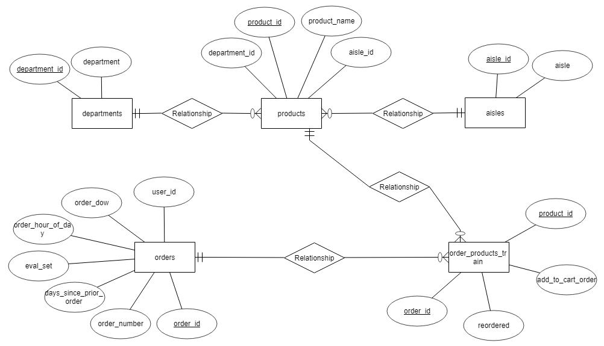
Data Model - Conceptual

Slide 16
Data Model - Logical
Logical data model is a translation or mapping of the conceptual data model towards a specific implementation environment
Can be a Hierarchical, CODASYL, Relational, Object-oriented, Graph, XML or NoSQL model
Clearly describes which data is stored where, in what format, which indexes are provided to speed up retrieval, etc.
Highly DBMS specific

Slide 17
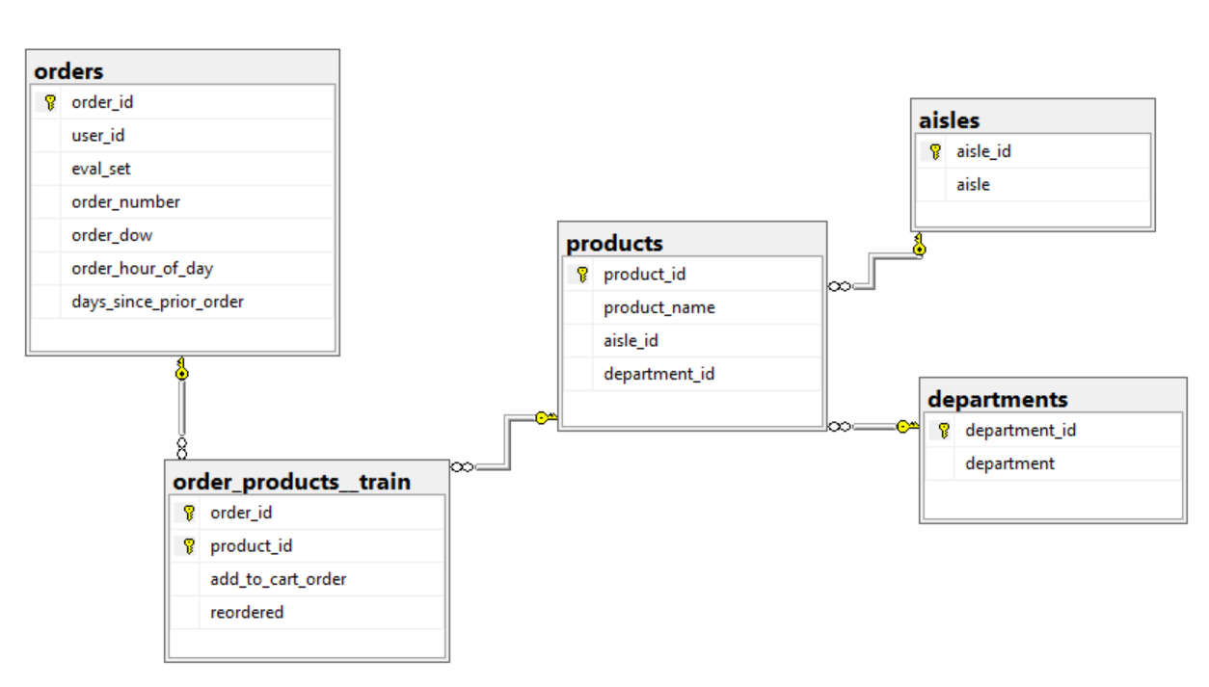
Data model - Logical

Slide 18
Data Model - Physical
Physical data model represents how the model will be built in the database
A physical database model shows all table structures, including column name, column data type, column constraints, primary key, foreign key, and relationships between tables
Convert entities into tables
Convert relationships into foreign keys
Convert attributes into columns

Slide 19
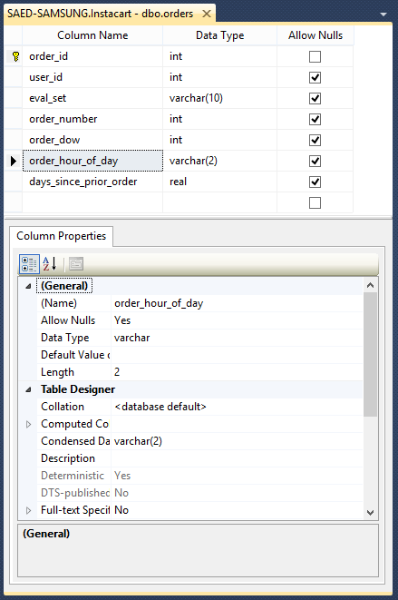
Data model - Physical

Slide 20
Data Model - External
External data model contains various subsets of the data items in the logical model, also called views, tailored towards the needs of specific applications or groups of users
SELECT
order_id
,user_id
,eval_set
,order_number
,order_dow
,[order_hour_of_day
,days_since_prior_order
FROM
orders
CREATE VIEW vw_orders_train
AS
SELECT
order_dow, count(*)
FROM
orders
GROUP BY
order_dow
ORDER BY
order_dow

Slide 21
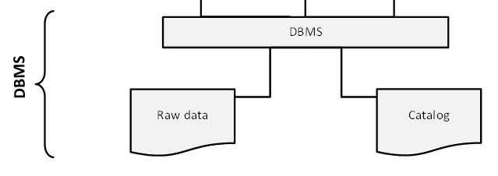
Catalog
Heart of the DBMS
Contains the data definitions, or metadata, of your database application
Stores the definitions of the views, logical and internal data models, and synchronizes these three data models to make sure their consistency is guaranteed

Slide 22
Database Users
Information architect designs the conceptual data model
Database designer translates the conceptual data model into a logical and physical data model
Database administrator (DBA) is responsible for the implementation and monitoring of the database
Application developer develops database applications in a programming language such as Java or Python
Business user will run these applications to perform specific database operations

Slide 23
Database Languages
Data Definition Language (DDL) is used by the DBA to express the database's external, logical and internal data models
definitions are stored in the catalog
Data Manipulation Language (DML) is used to retrieve, insert, delete, and modify data
DML statements can be embedded in a programming language, or entered interactively through a front-end querying tool
Structured Query Language (SQL) offers both DDL and DML statements for relational database systems

Slide 24
Thank You!

